Slide 1
Final Presentation
Data-X Project 18 Group 2: Predicting Mood Disorders
Jillian Chan, Yin Zhang, Yuyang Pan, Simarjeev Singh

Slide 2

About
Using clinical data to investigate & predict the incidence of
depression

Slide 3
LOCATION
FRANKFURT BIG DATA LAB
DATA-X TEAM
GEISINGER OFFICE

Slide 4
Timeline

Slide 5
OVERVIEW
Preliminary Research
Data Blending
Presentation Prep
Data Profiling
Machine Learning Classification

Slide 6
Sample Architecture
Geisinger dataset
Logistic Regression & Random Forest: classify + predict
Medical Reporting
Medical web articles
Storage: SQL/Pandas
Pre-emptive Diagnosis
SQL to merge dataframes
Pandas to sort & group data
External Feedback: Skype with Stanford Professors

Slide 7
2. Hypothesis Generation
Anxiety, Insomnia, Demographics → Depression

Slide 8
130,535
~90%
10.16%
Patients’ data from Geisinger dataset
with mood disorders
Patients with Insomnia + depression

Slide 9
Insomnia: A ticking clock for depression?
Research paper by Maurice M.Ohayon of Stanford University

Slide 10
DEPRESSION
ANXIETY
INSOMNIA
Initial research by Prof Ohayon
Prof. Cristina & team
Any of the three could be a trigger to the other two
Notes:
Main idea:
Chronic anxiety could cause insomnia (prevents from falling asleep)
Insomnia <---predispose----> depression & anxiety
Basically, the relationships among depression, insomnia & anxiety are multi-directional.
Any of the three could be a trigger to the other two
https://www.dukehealth.org/blog/vicious-cycle-insomnia-anxiety-and-depression
http://www.abc.net.au/news/2017-05-12/sleep-problems-anxiety-and-depression-link-goes-both-ways/8521582

Slide 11
Insomnia/Sleep Disorders
Anxiety
Age
Gender
Ethnicity
Drug Use
Smoking Status
Depression

Slide 12
3. Data Cleaning

Slide 13
DATA RECEIVED (all .csv)
Data Library
Medication Orders/Admin
Demographics
Problem List
Procedure/
Surgery History
Social History
Encounters (Chronological)
Labs

Slide 14
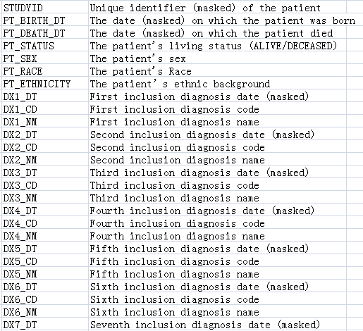
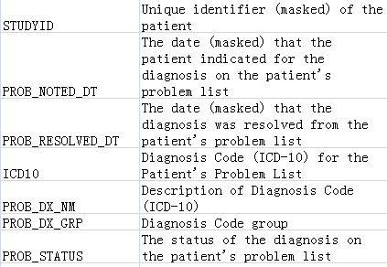
Demographics:
basic information of the patient, mental problem diagnoses for 7 encounters
Problem List:
Historical problem information of the patient
ICD10: WHO’s International Statistical Classification of Diseases and Related Health Problems

Slide 15
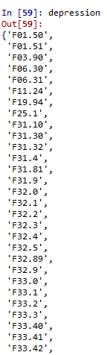
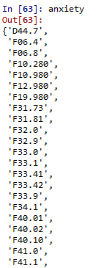
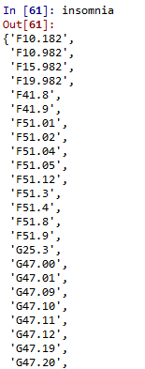
Steps
1. Find ICD10 Code of our target diseases: Depression, Insomnia, Anxiety

Slide 16
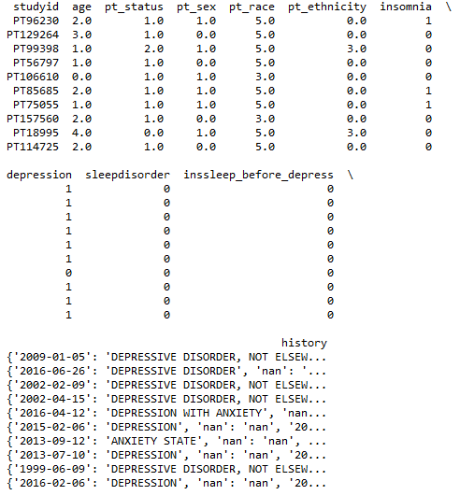
Initial Data Profiling
Tool: Pandas.DataFrame
age | 0-18 | 19-36 | 37-54 | 55-72 | 72+
 | 0 | 1 | 2 | 3 | 4
pt_sex | male | female
 | 0 | 1
pt_status | alive | deceased | unknown
 | 0 | 1 | 2
pt_ethnicity | Hispanic Or Latino | Not Hispanic Or Latino | unknown
 | 0 | 1 | 2
race | American Indian Or Alaska Native | Asian | Black Or African American | Native Hawaiian Or Other Pacific Islander | White | Other
 | 1 | 2 | 3 | 4 | 5 | 6
Notes:
Black / hispanic(bipolar) - more likely

Slide 17
Modified Data Profiling: One-Hot Encoding
1
Age |  | Race
age0 | 0-18 | race0 | Black
age1 | 19-36 | race1 | Asian
age2 | 37-54 | race2 | American Indian
age3 | 55-72 | race3 | Native Hawaiian
All age bands 0 | 72+ | race4 | White
 |  | All race bands 0 | Other
Age
Race
Gender
0
 | age0 | age1 | age2 | age3
0-18 | 1 | 0 | 0 | 0
19-36 | 0 | 1 | 0 | 0
37-54 | 0 | 0 | 1 | 0
55-72 | 0 | 0 | 0 | 1
72+ | 0 | 0 | 0 | 0
Notes:
Black / hispanic(bipolar) - more likely

Slide 18
4. Data Profiling

Slide 19
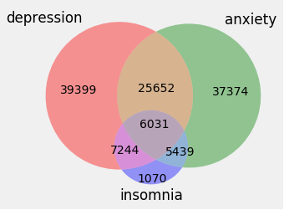
The distribution of patients

Slide 20
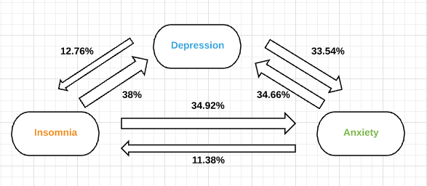

How do these 3 diseases trigger each other in our dataset
Percentage of patients flows from disease 1 to disease 2

Slide 21
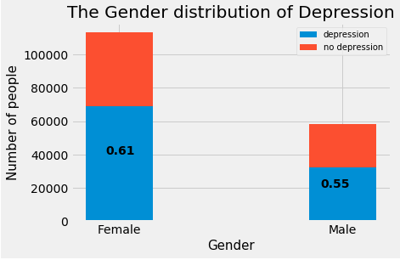
Gender
 | Medical Academia | Our Dataset
Men | 4.6%
Women | 5.8%
Conclusion | More women than men had major depressive disorder (MDD).
An Empirical Study: Epidemiology of depression and its treatment in the general population

Slide 22
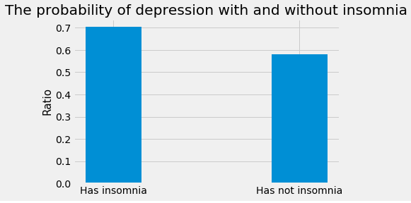
Insomnia & Depression
 | Medical Academia | Our Dataset
Insomnia & Depression | Insomnia increases the chance for developing depression
Conclusion | The probability of depression will increase a lot if a person suffers from insomnia.
https://www.dukehealth.org/blog/vicious-cycle-insomnia-anxiety-and-depression

Slide 23
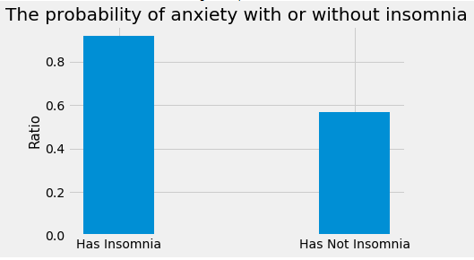
Insomnia & Anxiety
 | Medical Academia | Our Dataset
Insomnia & Anxiety | Insomnia increases the chance for developing anxiety; Chronic anxiety could cause insomnia (prevents from falling asleep).
Conclusion | The probability of anxiety increases if a person suffers from insomnia.
https://www.dukehealth.org/blog/vicious-cycle-insomnia-anxiety-and-depression

Slide 24
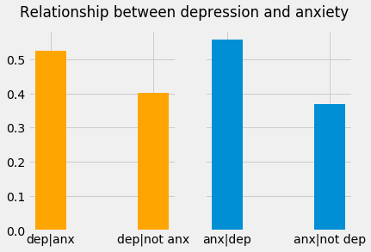
Depression & Anxiety
 | Medical Academia | Our Dataset
Depression & Anxiety | The relationships among depression, insomnia & anxiety are multi-directional. Depression and anxiety are positively related.
Conclusion | Depression and anxiety are positively related.
Notes:
Depression and anxiety disorders are different, but people with depression often experience symptoms similar to those of an anxiety disorder, such as nervousness, irritability, and problems sleeping and concentrating. But each disorder has its own causes and its own emotional and behavioral symptoms.
Many people who develop depression have a history of an anxiety disorder earlier in life. There is no evidence one disorder causes the other, but there is clear evidence that many people suffer from both disorders.

Slide 25
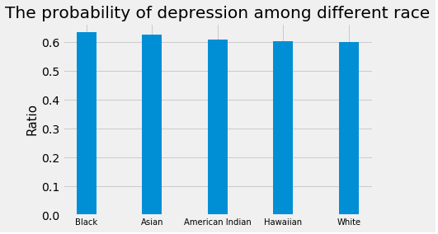
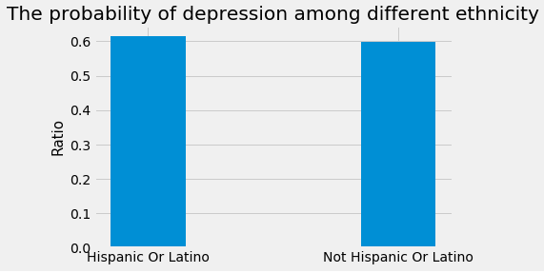
Race & Ethnicity
A report published by researchers at the University of Wisconsin found that poverty, parenting, racial and gender discrimination put black women — particularly low-income black women — at greater risk for major depressive disorder (MDD).
 | Medical Academia | Our Dataset
Ethnicity | Opposite results! According to a 2010 study by the CDC, African-Americans have the highest rate of recurrent depression, followed by Hispanics, and whites Prevalence of major depressive disorder was significantly higher in Whites than in African Americans and Mexican Americans
Conclusion | Black people has the highest probability to have depression
Retrieved from: https://www.everydayhealth.com/hs/major-depression/depression-statistics/

Slide 26
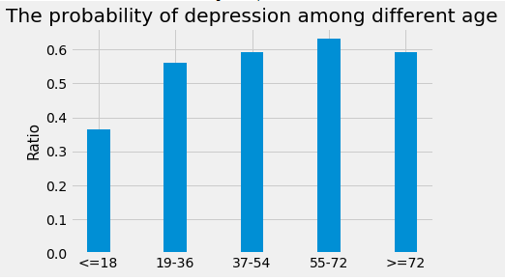
Age
 | Medical Academia | Our Dataset
Ages | People age from 40 to 59 have the highest possibility of getting depression.
Conclusion | Before 72, the probability of depression increase with aging After 72, the probability of depression decrease with aging

Slide 27
5. Data Blending

Slide 28
Data Blending
Tool: Pandas.DataFrame
insomnia | yes | no
 | 1 | 0
ins_before_dep | yes | no
 | 1 | 0
depression | yes | no
 | 1 | 0
dep_before_ins | yes | no
 | 1 | 0
anxiety | yes | no
 | 1 | 0
anx_before_dep | yes | no
 | 1 | 0
anx_before_ins | yes | no
 | 1 | 0
dep_before_anx | yes | no
 | 1 | 0
ins_before_anx | yes | no
 | 1 | 0
Each row of “history” column is a dictionary, which are the historical records of the patient.
Keys: time period (datetime)
Values: disease name

Slide 29
6. Classification Models
Logistic Regression, Random Forest

Slide 30
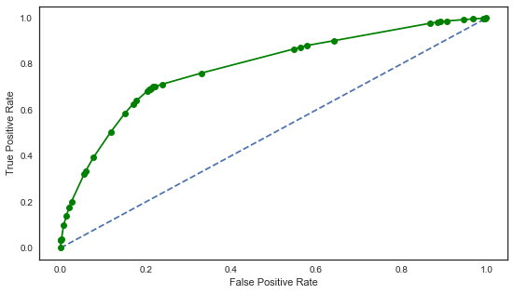
Initial accuracy
Model | Accuracy Score (% of accurate predictions)
Logistic Regression | 73.64%
Random Forest | 73.91%
KNN | 69.91%
XGBoost | 73.79%
SVC | 73.66%
Random forest ROC curve

Slide 31
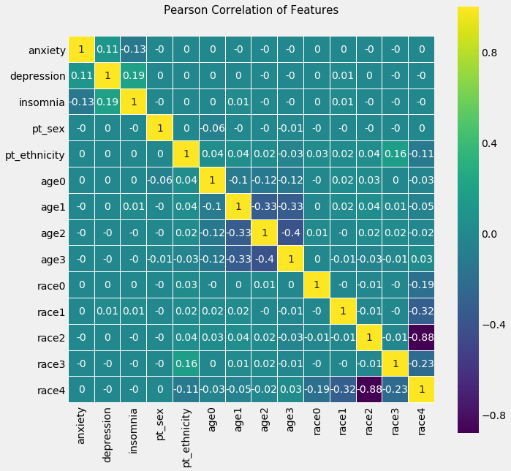
Pearson Correlation Matrix
Pearson correlation coefficients:
corr(depression,insomnia)=0.19
corr(depression,anxiety)=0.11

Slide 32
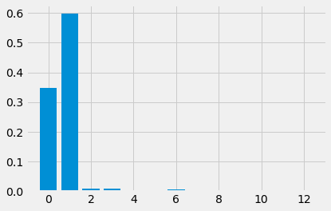
Random Forest
Classifier
The importance of features for RF classifier
Anxiety
Insomnia
Testing data: 20%, training data: 80%, number of trees=1000
The Accuracy of our model: 70.4%

Slide 33
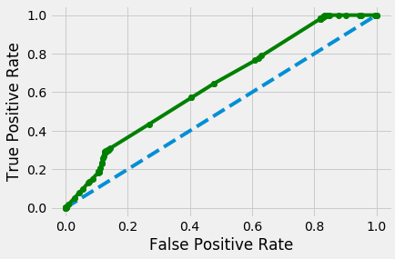
Logistic
Regression
Coefficients of each feature for LogReg
anxiety
insomnia
pt_sex
pt_ethnicity
age0
age1
age2
age3
race0
race1
race2
race3
race4
intercept
0.92
1.17
-0.0018
0.034
-0.022
-0.0038
-0.026
-0.0113
0.49
0.315
0.22
0.24
0.26
-1.72
Testing data: 20%, training data: 80%
The Accuracy of our model: 67.4%

Slide 34
Review
Hypothesis Generation | Data Cleaning | Data Blending

Slide 35
Conclusion

Slide 36
Anxiety + Insomnia
are signals for depression

Slide 37
Future Steps
1 Model Accuracy: Classifier Parameters
Tune the random forest parameters:
testing out multiple minimum sample leaf sizes
ensemble classification techniques such as bagging (bootstrap aggregating) and boosting
a more targeted train-test-split
sorting the patients’ data by year and using the first few years’ data as training set and the last few years as testing set
2 Model Accuracy: Adding Features
Add features (drug use, alcohol consumption, smoking habit) to the model

Slide 38
References
Ohayon, M. M. (2007). Insomnia: A ticking clock for depression? Journal of Psychiatric Research, 41(11), 893-894.
Ohayon, M. M. (2005). Relationship between chronic painful physical condition and insomnia. Journal of Psychiatric Research, 39(2), 151-159.
Ohayon, M. M., & Milesi, C. (2016). Artificial Outdoor Nighttime Lights Associate with Altered Sleep Behavior in the American General Population. Sleep, 39(6), 1311-1320.
Ohayon, M. M., & Roberts, L. W. (2015). Challenging the validity of the association between oversleeping and overeating in atypical depression. Journal of Psychosomatic Research,78(1), 52-57.
Ohayon, M. M. (2007). Epidemiology of depression and its treatment in the general population. Journal of Psychiatric Research, 41(3-4), 207-213.
Ohayon, M. M. (2002). Epidemiology of insomnia: what we know and what we still need to learn. Sleep Medicine Reviews, 6(2), 97-111.
What is data blending, By Oleg Roderick, David Sanchez, Geisinger Data Science, November 2015
Predicting Mood Disorder Risk A Data Blending and Machine Learning Approach MASTER’S THESIS by Alex Klein and Florian Reifschneider
Unicorns Live in Venn Diagrams: What to Expect from Data Science for Healthcare, and What is Missed When Too Much is Expected. Oleg Roderick, Ph.D. and Nicholas Marko, MD Geisinger Medical Center, Danville, PA USA

Slide 39



The Team
Jillian Chan, IEOR
Yin Zhang, IEOR
Raina Pan, IEOR
Simarjeev Singh, EECS

Slide 40
Thank you for listening!

